Slide 1

MAKERdao
Emanuell Dan Minciu
Web Developer @Moneysupermarket

Slide 2
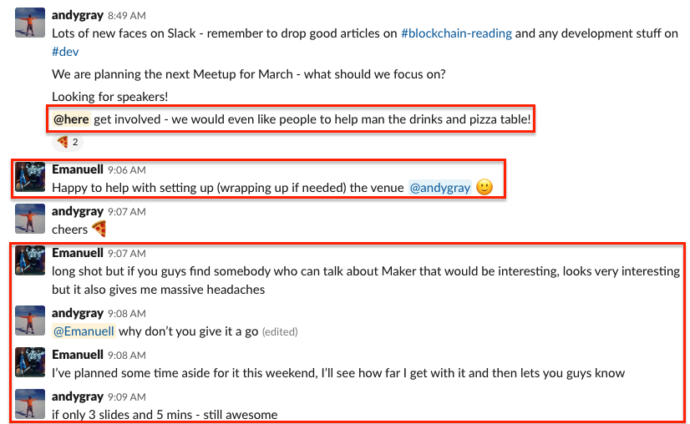
How did I get here?
Notes:
Dai Stayed at $1 While ETH Crashed From $1,400 to $85

Slide 3
Maker – a platform for stability
Build on top of Ethereum
A system made of smart contracts
CDP (collateral debt position) is the most widely used
Fairly old, 2015
No ICO
1,000,000 MKR (350,000 held by the foundation distributed over time)
Notes:
It started being distributed amongst friends, family, investors such as Polychain and Andreessen Horowitz and other early adaptors in their user chats.

Slide 4
Mkr holders
Have voting power
Decide on collateral
Decide the collateralization/liquidation ratio
Decide the stability fee
Choose a set of Price Oracles
Choose the Emergency Oracles (in single collateral Dai)
Bail out the system
Share profits but also loses

Slide 5

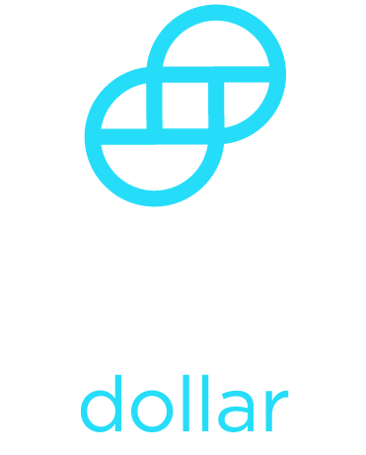

Dai
1 Dai = $1
Backed by collateral (Ether)
Lives completely on the blockchain
First stable coin not to rely on a legal system
Notes:
Most stable coins can break the peg in the future (similar to the dollar back in 1970)

Slide 6
Single Collateral Dai & Multi Collateral Dai
Pooled Ether or PETH (Temporary mechanism for Single Collateral Dai)
Multi Collateral will bring more stability
Notes:
Other collateral types that Maker will bring – cryptocurrencies, gold, stocks, real estate, etc.

Slide 7
Loans
Traditional system
Maker system
Go to the bank
Put your house as collateral in exchange for cash
If your house value decreases:
Pay the loan back
Or, the bank takes your house
Go to Maker
Lock Ether in the CDP smart contract in exchange for Dai
If Ether value drops:
Pay the smart contract back
Or, the CDP will auction off your Ether to the highest bidder

Slide 8
Collateral debts positions
Step 1: Creating the CDP and depositing collateral
One transaction to create the CDP
A second one with the collateral/input (Ether) used to generate Dai
Step 2: Generating Dai from the collateralized CDP
A transaction is sent to retrieve Dai and in return the CDP accrues an equivalent amount of debt
Step 3: Paying down the debt and stability fee
Step 4: Withdrawing collateral and closing the CDP
A final transaction is sent to Maker to retrieve back the collateral

Slide 9
Stability Fee
Decided by MKR holders
Continuously accrues on debt over time
Can only be paid in MKR (or Dai if using the CDP Portal UI)

Slide 10
Example 1
Bob needs a loan, so he decides to generate 100 Dai. He locks an amount of ETH worth significantly more than 100 Dai into a CDP and uses it to generate 100 Dai. The 100 Dai is instantly sent directly to his Ethereum account. Assuming that the Stability Fee is 1% per year, Bob will need 101 Dai to cover the CDP if he decides to retrieve his ETH one year later.
One of the primary use cases of CDPs is margin trading by CDP users.
Notes:
One use case here is to escape paying capital gains on your ETH.

Slide 11
Example 2
Bob wishes to go margin long on the ETH/DAI pair, so he generates 100 USD worth of Dai by posting 150 USD worth of ETH to a CDP. He then buys another 100 USD worth of ETH with his newly generated Dai, giving him a net 1.66x ETH/USD exposure. He’s free to do whatever he wants with the 100 USD worth of ETH he obtained by selling the Dai. The original ETH collateral (150 USD worth) remains locked in the CDP until the debt plus the Stability Fee is covered.

Slide 12
Automatic liquidations of risky CDPs
Triggered when a CDP hits its liquidation ratio
Maker buys the collateral of the CDP and auctions it
Initial CDP owner will get back the leftover collateral minus the debt, stability fee and liquidation penalty

Slide 13
Example
Let's assume that there is an Ether CDP type with a Liquidation Ratio of 145%, a Penalty Ratio of 105%, and we have an Ether CDP with a collateral-to-debt ratio of 150% . The Ether price now crashes 10% against the Target Price, causing the collateral-to-debt ratio of the CDP to fall to ~140%. As it falls below the Liquidation Ratio, traders can trigger its Liquidation and begin bidding with Dai for buying MKR in the debt auction. Simultaneously, traders can begin bidding with Dai for buying the ~140 Dai worth of collateral in the collateral auction. Once there is at least 105 Dai being bid on the Ether collateral, traders reverse bid to take the least amount of collateral for 105 Dai. Any remaining collateral is returned to the CDP owner.

Slide 14
Emergency Shutdown – Black swan event
Formerly known as Global Settlement
Triggered by Emergency Oracles
If the platform gets attacked
If a technical upgrade to the platform is scheduled
When there’s an instant 70% market crash
Or, an 80-85% market crash over 8 hours
Users are not able to create Dai anymore
Dai holders can redeem back $
Notes:
In Multi Collateral Dai the process is fully decentralized and controlled by MKR voters who can trigger this by depositing MKR into the emergency shutdown contract. – 50,000 MKR target.

Slide 15
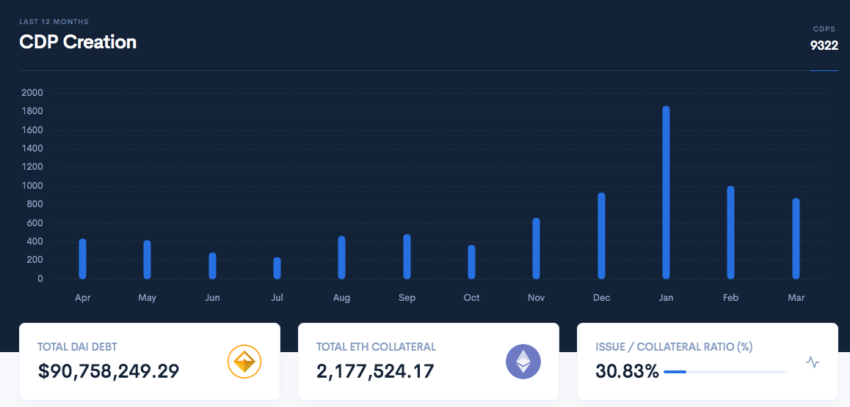
Adaption

Slide 16
Resources
MakerDAO.com
https://makerdao.com/
Maker for Dummies: A Plain English Explanation of the Dai Stablecoin
https://medium.com/cryptolinks/maker-for-dummies-a-plain-english-explanation-of-the-dai-stablecoin-e4481d79b90
Maker for Dummies, Part 2
https://medium.com/@greg_10160/maker-for-dummies-part-2-3b364f86bbfd
Rune Christensen – Maker DAO and DAI Stable Coin
https://www.youtube.com/watch?v=hg5-uzrAgiI
MakerScan (CDPs creation & transactions)
https://makerscan.io/
ETH locked in DeFI
https://mikemcdonald.github.io/eth-defi/

